Slide 1
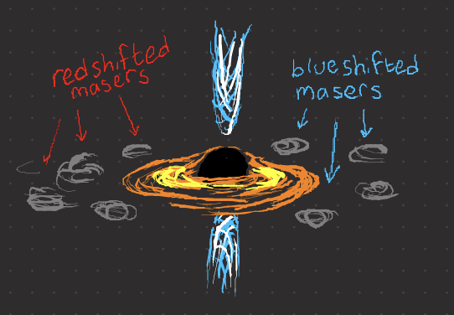
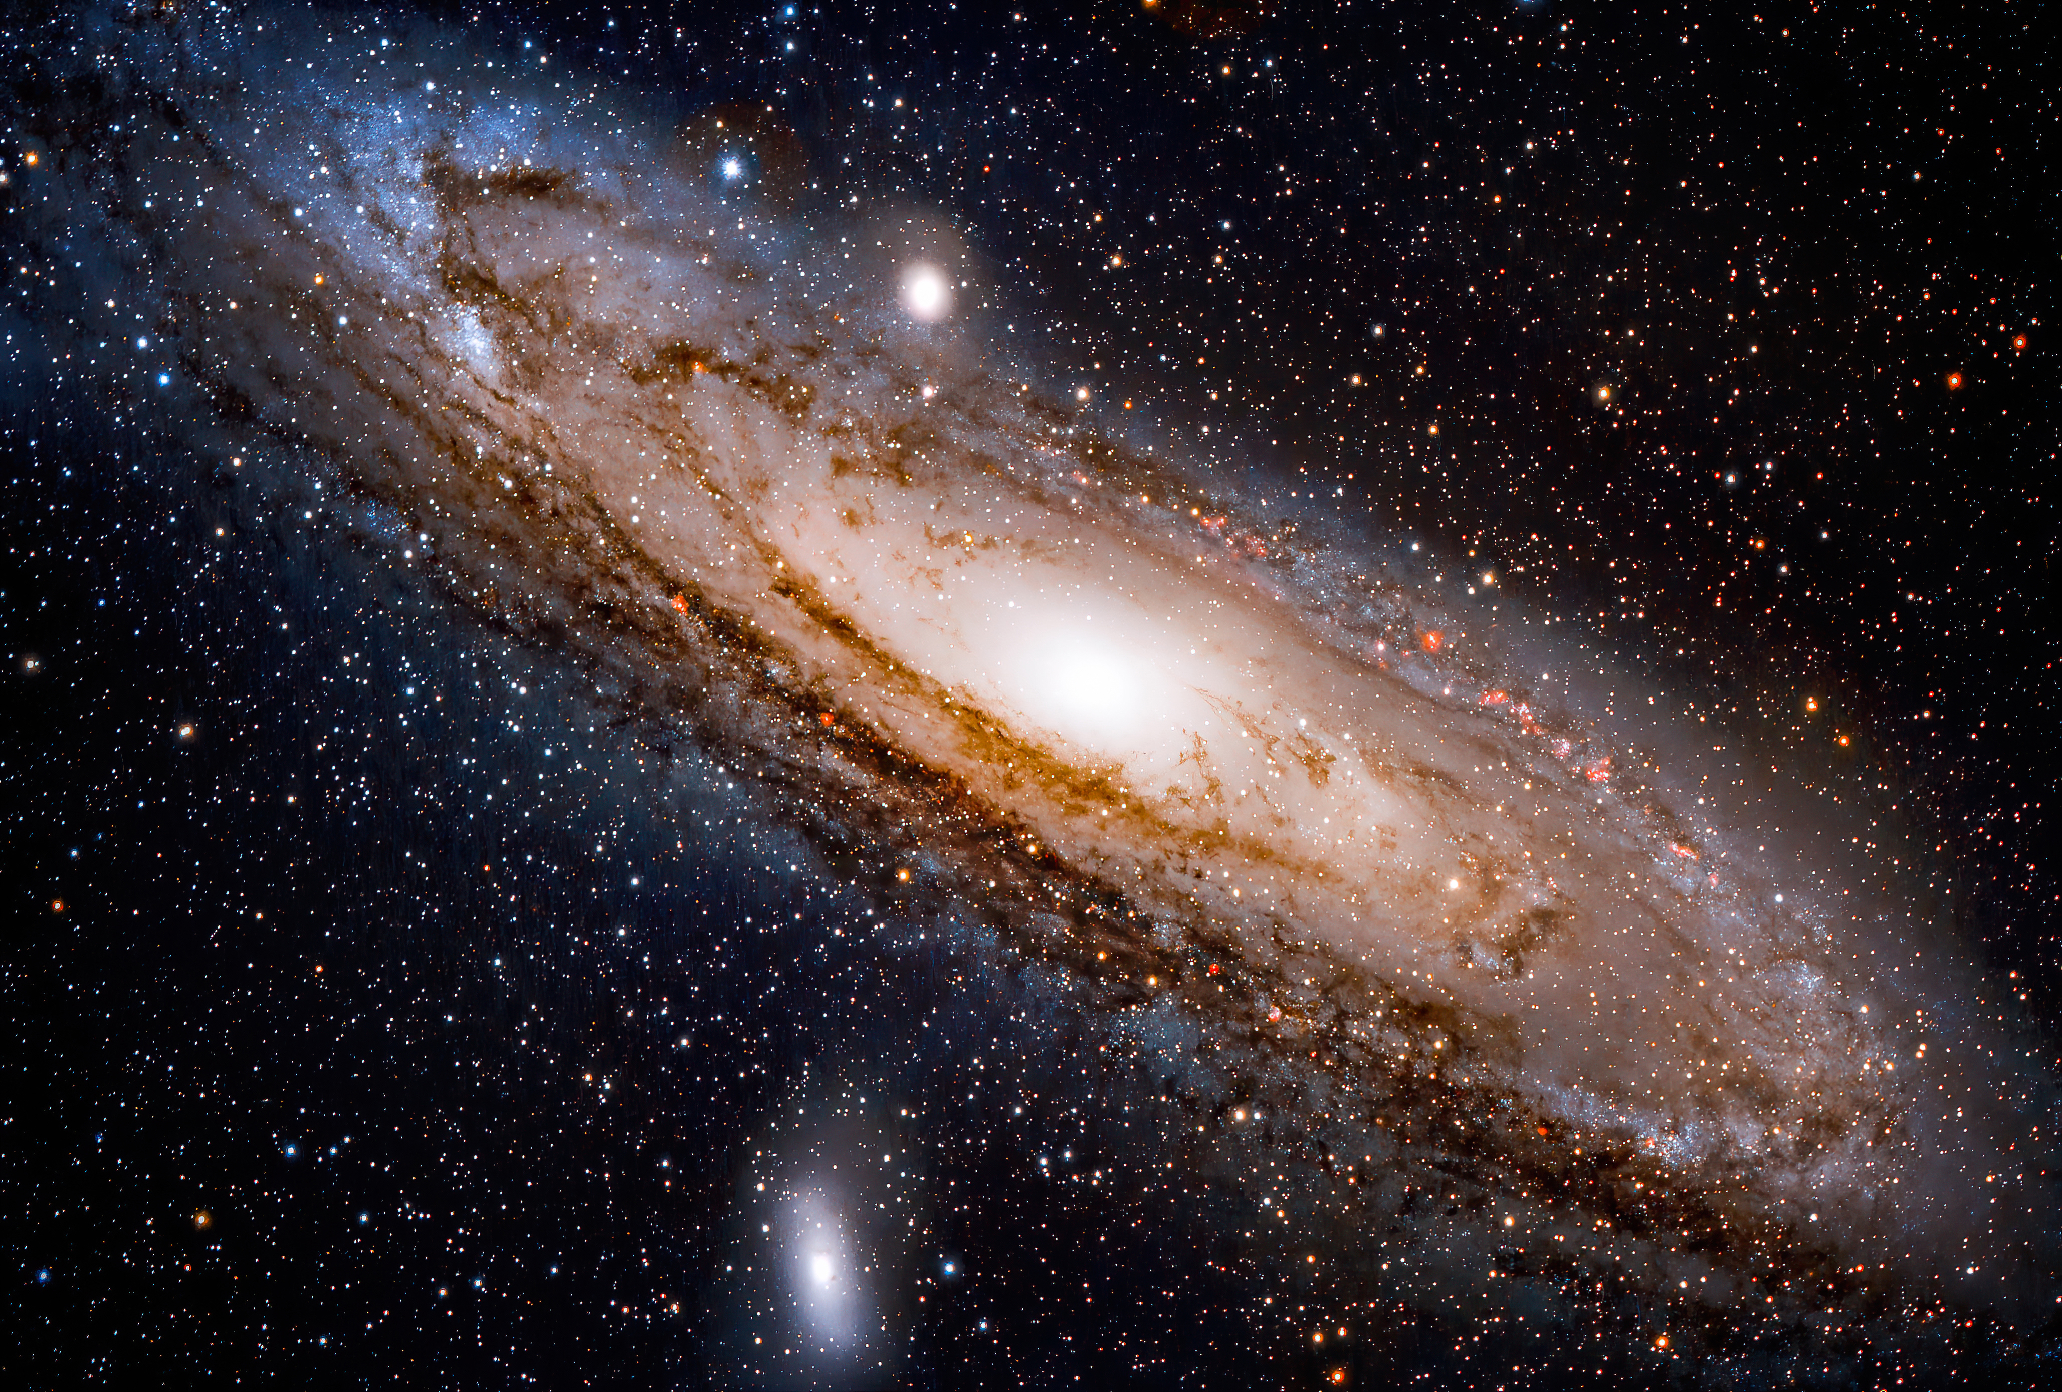
Probing the AGN Nature of Maser Galaxy Hosts
Gaudeor Rudmin
Dr. Anca Constantin
James Madison University
Summer 2023
From Dayag 2019

Slide 2
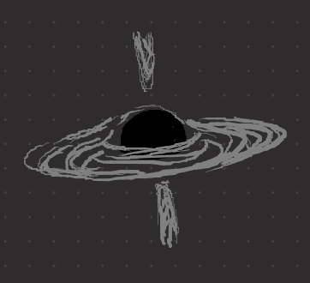
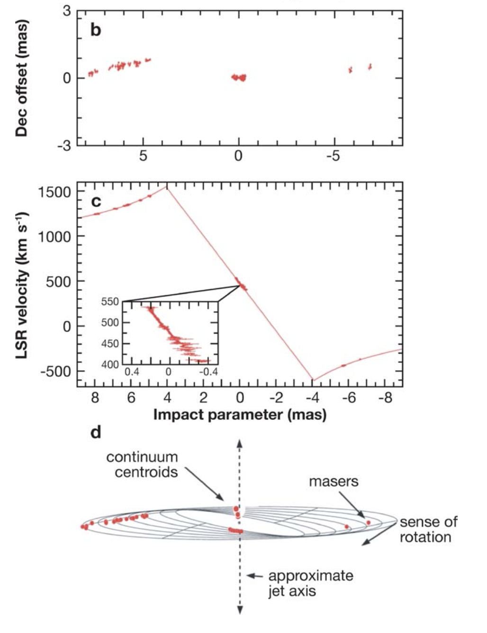

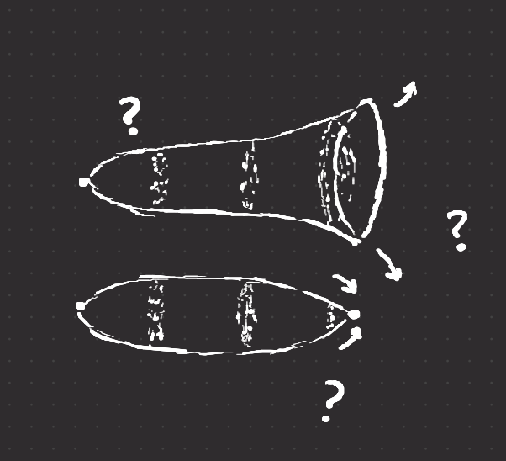
Why do we care about Maser Emission?
How massive are supermassive black holes?
How far away are other galaxies?
How do we refine cosmological models?
What is the fate of the universe?
Geometric Measurement via
Newtonian Physics
Masers are extremely rare:
< 3.6% of surveyed galaxies are masers
< 0.7% of surveyed galaxies are masers in a disk configuration (useful)

Slide 3
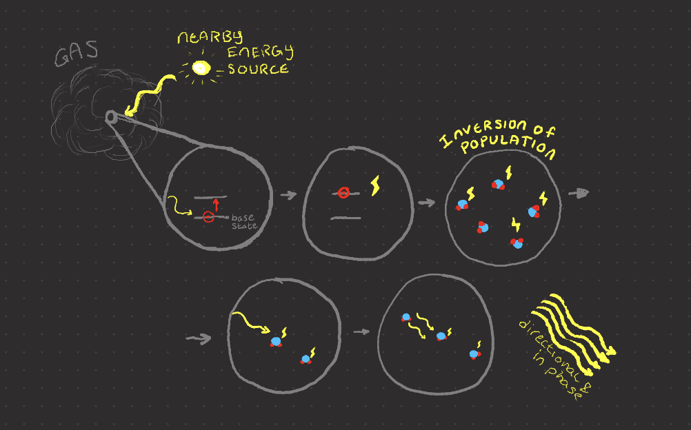
What are Masers?
Laser in
Microwave
Emitted by hot,
high density (for space)
gas with a nearby energy source
Type based on energy source

Slide 4
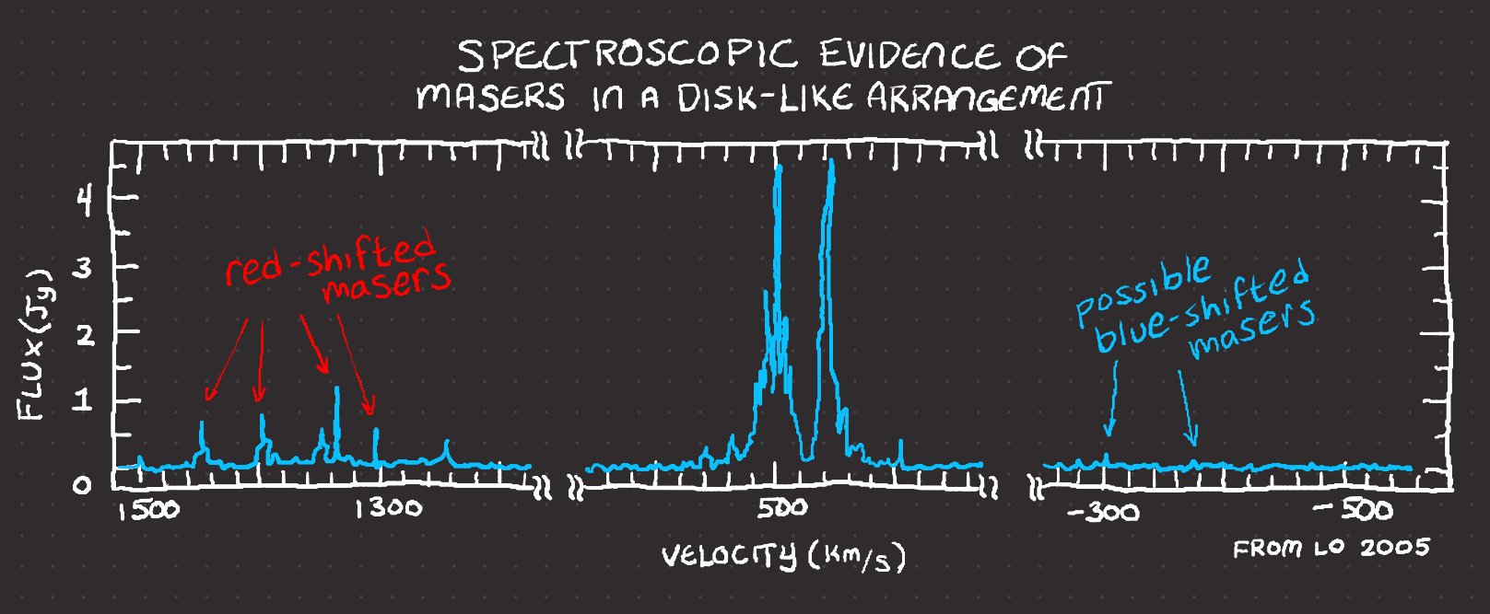



Types of Masers
Masers near Star-forming areas
MegaMasers (1 M x more luminous)
From Galaxy Centers
Maser Disks (Rare)

Slide 5
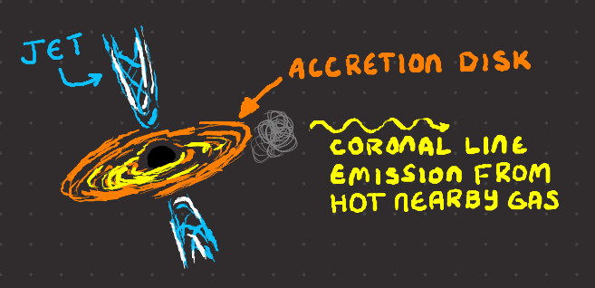
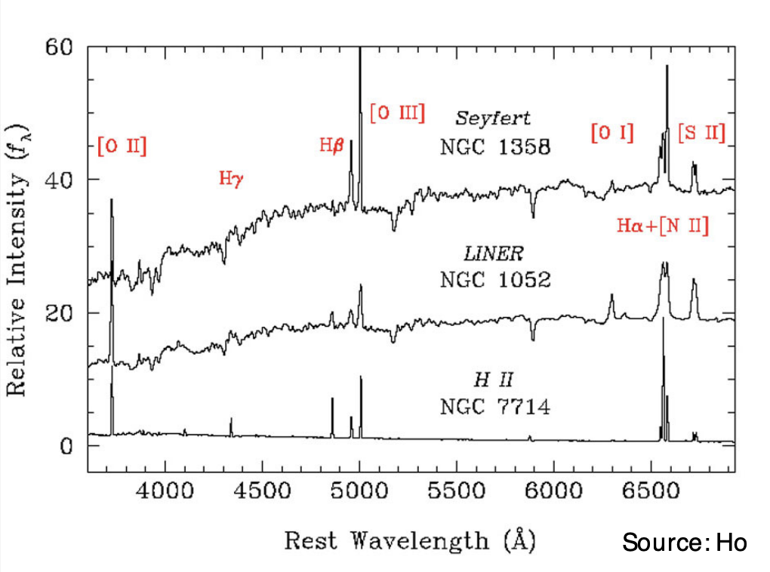
Active Galactic Nucleus (AGN)
A black hole feasting at the center of a Galaxy on an accretion disk of gas and dust.
We know more about AGN than
about masers, so finding a
connection could help us understand
megamasers’ properties.
AGN Identification
Xray | Mid-Infrared (discussed by Emily McPike)
Radio | Optical Spectroscopic Lines
Variability | Coronal Spectroscopic Lines
From Ho 2008

Slide 6
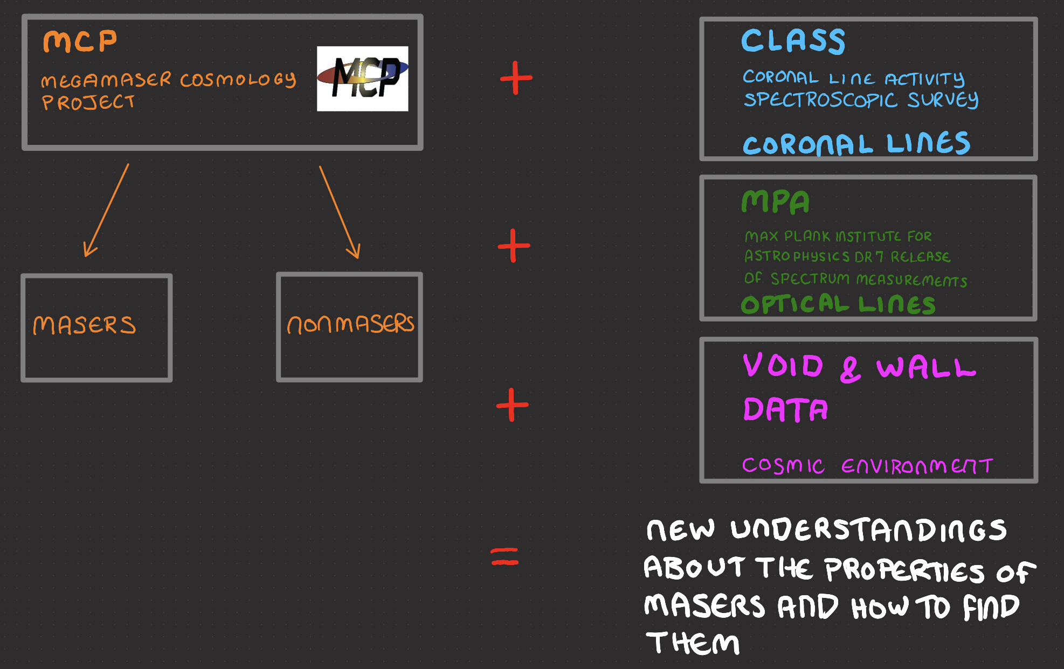

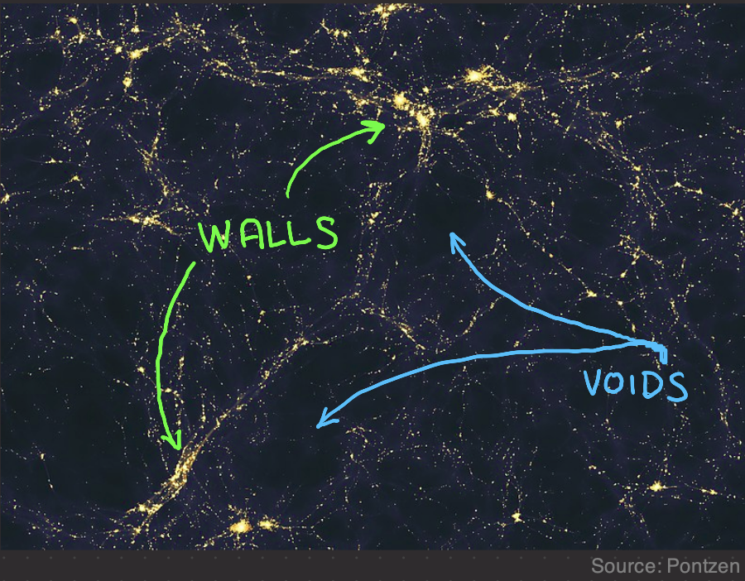
The Data

Slide 7
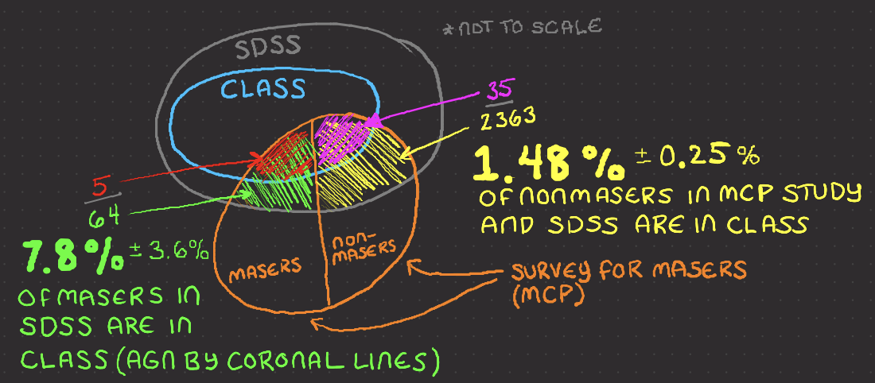
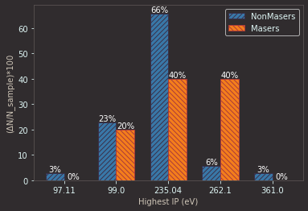
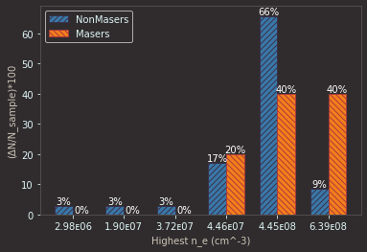
Masers VS Coronal Line AGN
A higher percentage of
Masers have coronal
Lines (so are AGN) than
non-masers.
Physical Properties
associated with
coronal Lines

Slide 8
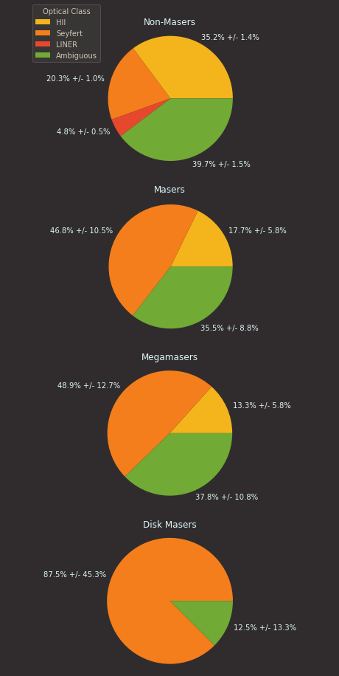
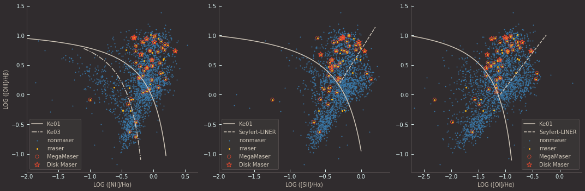
Masers VS Optical Line AGN
Masers are concentrated in the Seyfert AGN area.
Disk Masers are almost exclusively Seyfert AGNs
AGN
Seyfert AGN
Seyfert AGN
Star-Forming
Star-Forming
Star-Forming
LINER AGN
LINER AGN

Slide 9
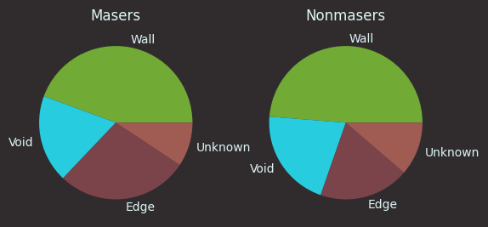
Masers VS Cosmic Environment
Location | Masers | Non-masers
Wall | 44.4% +/- 10.9% | 48.7% +/- 1.8%
Void | 18.5% +/- 6.4% | 20.9% +/- 1.1%
Edge | 27.8% +/- 8.1% | 19.0% +/- 1.0%
Unknown | 9.3% +/- 4.3% | 11.3% +/- 0.8%
From Pontzen

Slide 10
Conclusions
There were statistically significant differences between Masers and Nonmasers using:
Coronal Line AGN Detection
Optical Line AGN Detection
They may be useful tools in narrowing the search for usable Maser Disks
Galaxy’s location in the cosmic environment does not seem to be a useful tool.

Slide 11
References
Dayag, D. (2019). Andromeda Galaxy 560mm FL. Wikimedia Commons. Retrieved July 25, 2023, from https://commons.wikimedia.org/wiki/File:Andromeda_Galaxy_560mm_FL.jpg.
Ho, L. C. (2008). Nuclear Activity in Nearby Galaxies. Annual Review of Astronomy and Astrophysics, 46(1), 475–539. https://doi.org/10.1146/annurev.astro.45.051806.110546
Keel, B. (2002, November). Optical Spectra of Various Kinds of Active Galactic Nuclei. Active Galaxies and Quasars - Spectrum Comparison. https://pages.astronomy.ua.edu/keel/agn/spectra.html
Lo, K. Y. (2005). Mega-masers and Galaxies. Annual Review of Astronomy and Astrophysics, 43(1), 625–676. https://doi.org/10.1146/annurev.astro.41.011802.094927
Pontzen, A., &amp; Governato, F. (2014). Large-scale Structure of Light Distribution in the Universe. Wikimedia Commons. Retrieved July 25, 2023, from https://commons.wikimedia.org/wiki/File:Large- scale_structure_of_light_distribution_in_the_universe.jpg.
Reefe, M., Satyapal, S., Sexton, R. O., Doan, S. M., Secrest, N. J., &amp; Cann, J. M. (2022).
Class: Coronal line activity spectroscopic survey. The Astrophysical Journal, 936(2), 140.
https://doi.org/10.3847/1538-4357/ac8981

Slide 12
Thanks To:
Dr. Constantin for help with everything
Emily McPike for help understanding AGN
Anish Aradhey for help with void and wall data
REU symposium
NSF for funding REU with grant #CHE-2150091

